Slide 1
Real-Time Cryptocurrency Analysis System

Slide 2
Motivation
Sharp cryptocurrency market volatility
Social media opinion is a good indicator of market price
Real-Time analyzation tool helps decision making

Slide 3
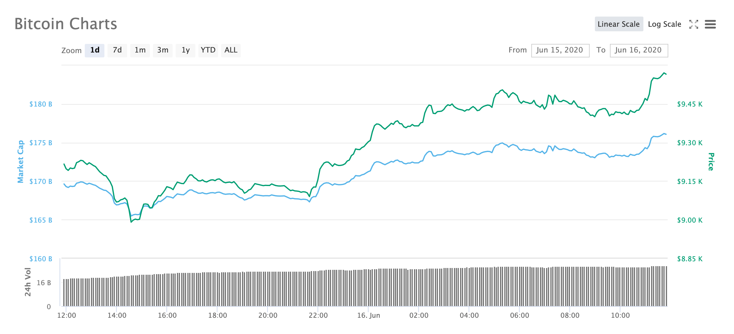
Sharp cryptocurrency market volatility

Slide 4
Social media opinion is a good indicator of market price

Slide 5
Objective
Develop a cryptocurrency analyzation system that can handle massive amount of data in real-time.

Slide 6
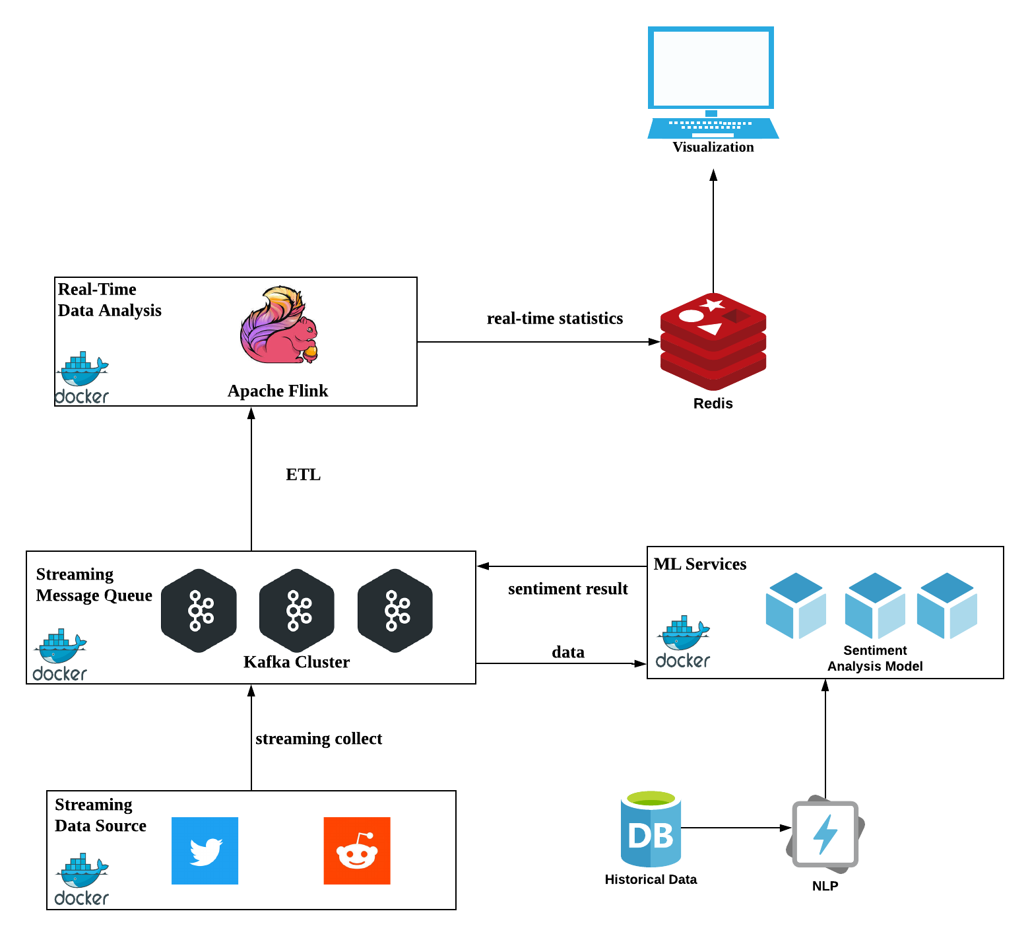
System Architecture

